Slide 1
Azure ML
Goal: detect anomalous data

Slide 2
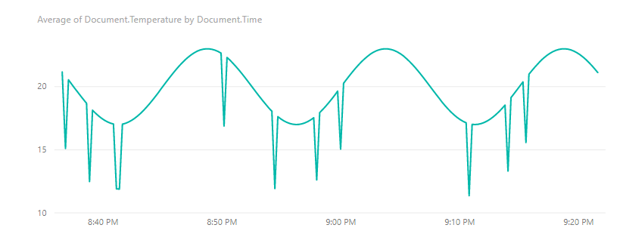
The Problem
Notes:
The problem here is that we’re producing some really weird values. There must be something wrong with our sensor or something else weird is going on. We’d like to try to fit our data within a sensible set of values.

Slide 3
Can we use Azure ML?
http://azuremlsimpleds.azurewebsites.net/

Slide 4

Classical Classifiers

Slide 5
Classical Classifiers
Class 1
Class 2

Slide 6
Using One-Class Support Vector Machine
Class 1
Class 2
Notes:
A one class SVM allows you to more strongly recognize things which are normal as opposed to abnormal. Consider a factory where a piece of machinery for which we cannot simulate all the failure conditions. A SVM allows us to

Slide 7
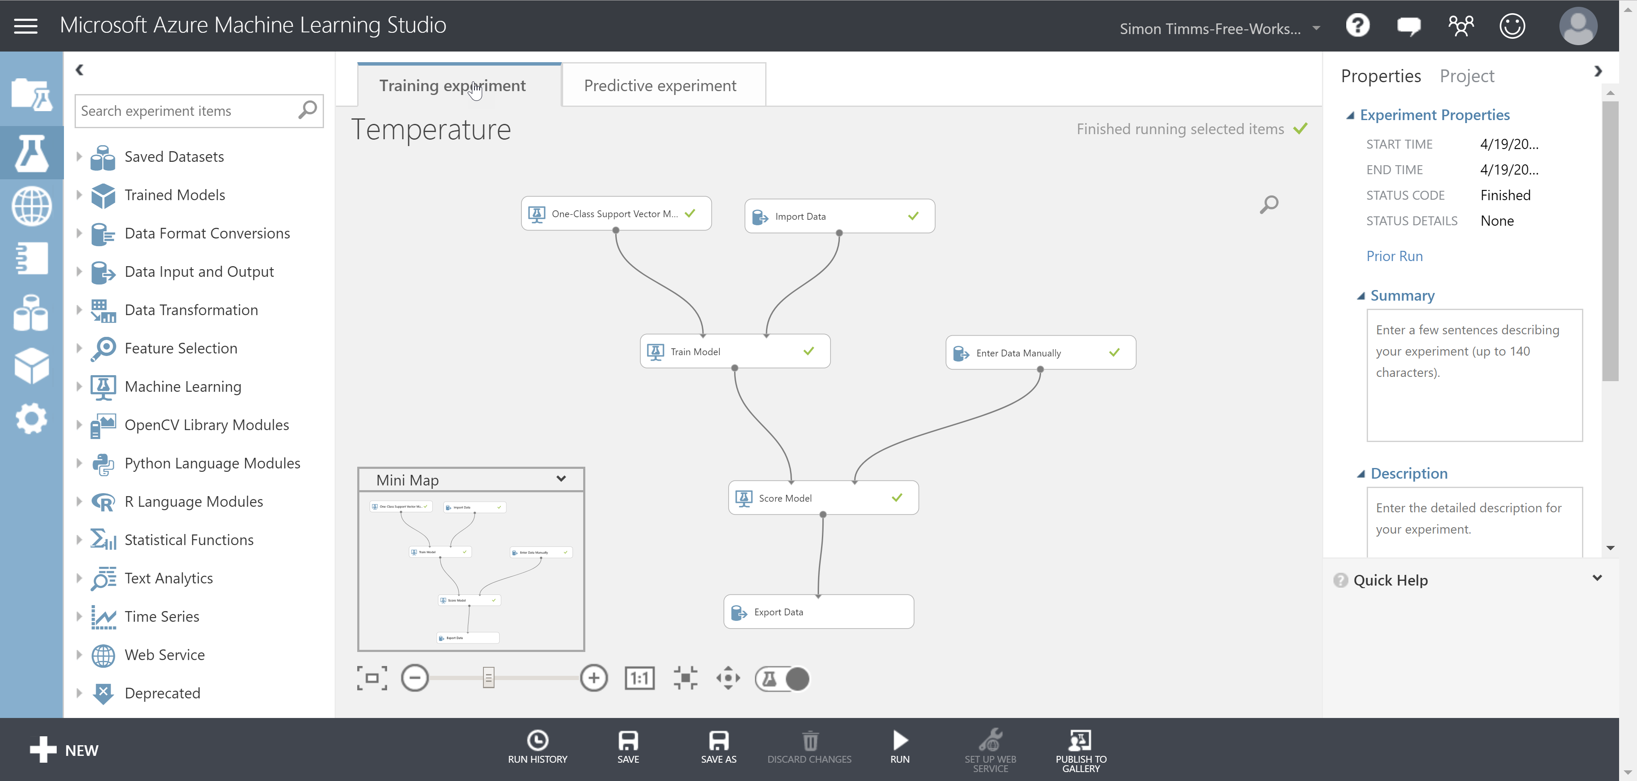
Using the Azure ML Studio
https://studio.azureml.net/
Notes:
Let’s start building.

Slide 8
Steps
Add a data import step pointing at your cosmos db instance
Enter the query SELECT temperature.deviceid, temperature.temperature FROM temperature where temperature.temperature >= 17 and temperature.temperature <= 23
Add a one class SVM with a single parameter
Hook up the first two to a train model
Add a sample data set by adding a manual entry data source
Hook up the model and the train model to a score model
Run the model and check if your manual entries are properly classified

Slide 9
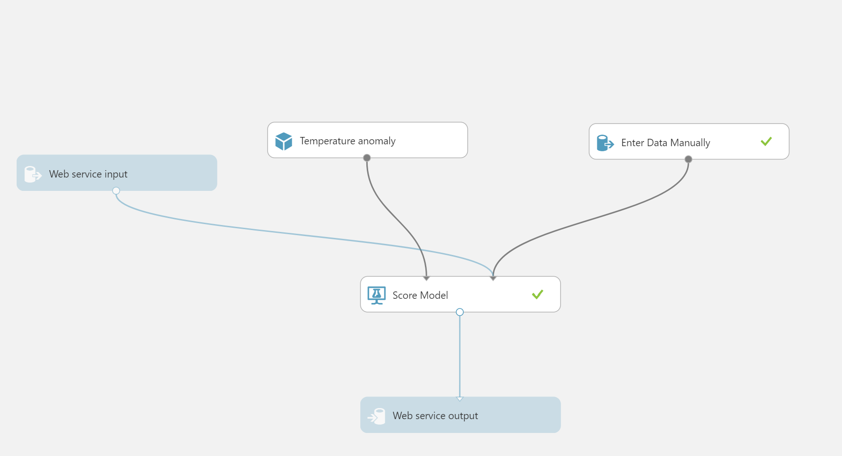
Steps
Convert the experiment to a predictive experiment
Export the trained model
Create a new experiment with the model
Click deploy web service
In stream analytics add a function call to your web service and update the query to use that call for a new column called ‘fit’
In Power BI filter for anything where fit=0

